Slide 1
Bitcoins & Blockchains
in a minute…

Slide 2


Slide 3
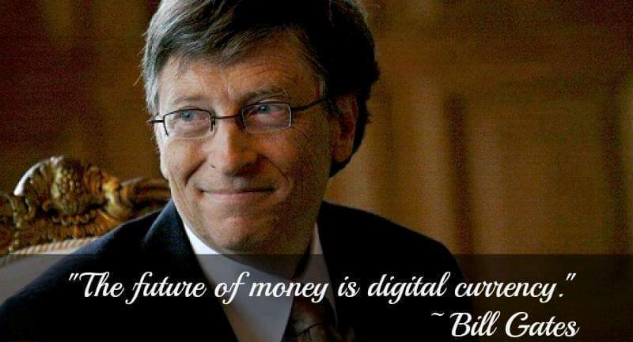

Slide 4
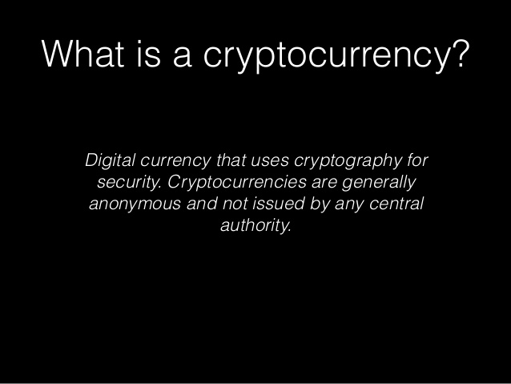

Slide 5
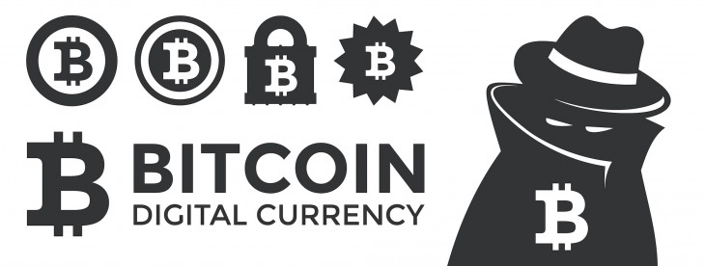

Slide 6
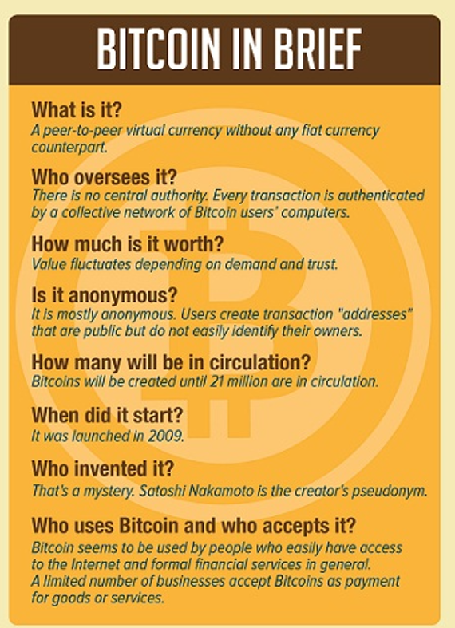

Slide 7
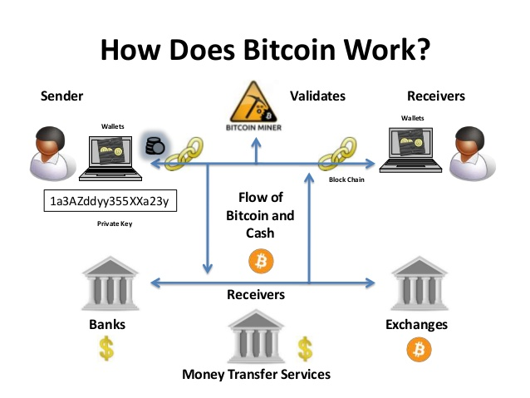

Slide 8
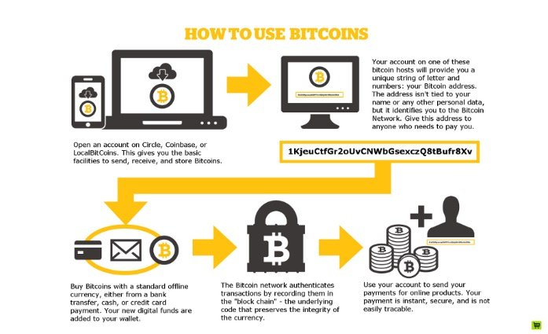

Slide 9
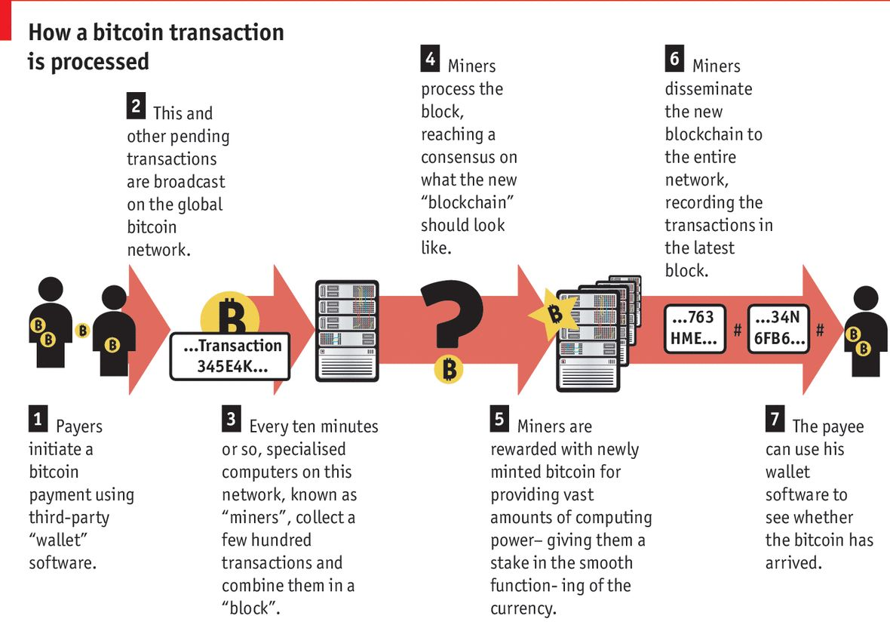

Slide 10


Slide 11
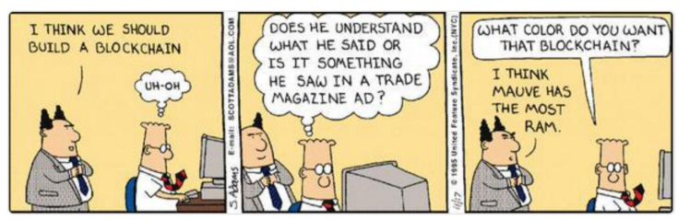

Slide 12
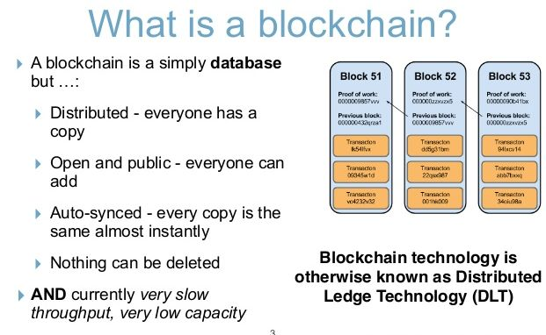

Slide 13
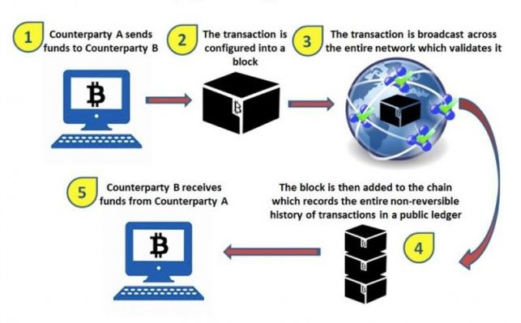

Slide 14
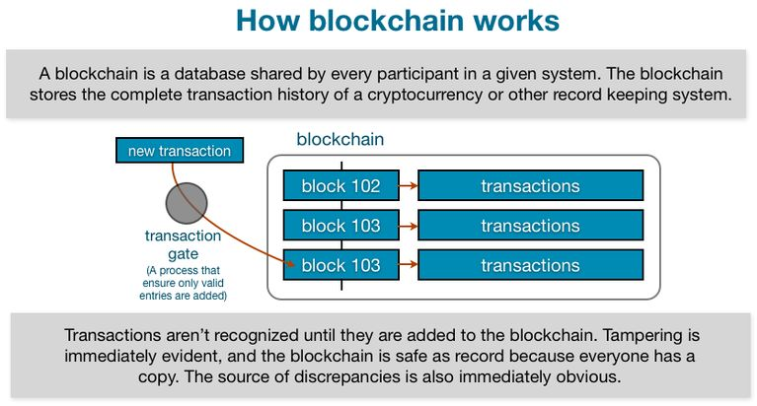

Slide 15


Slide 16
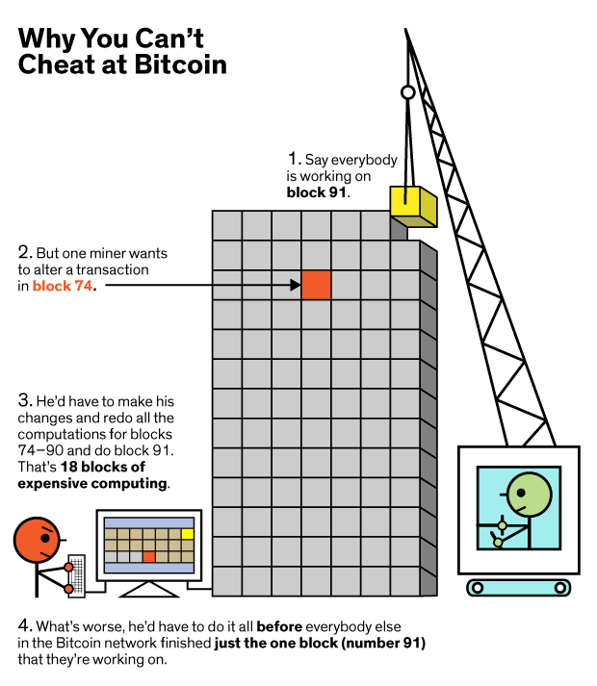

Slide 17
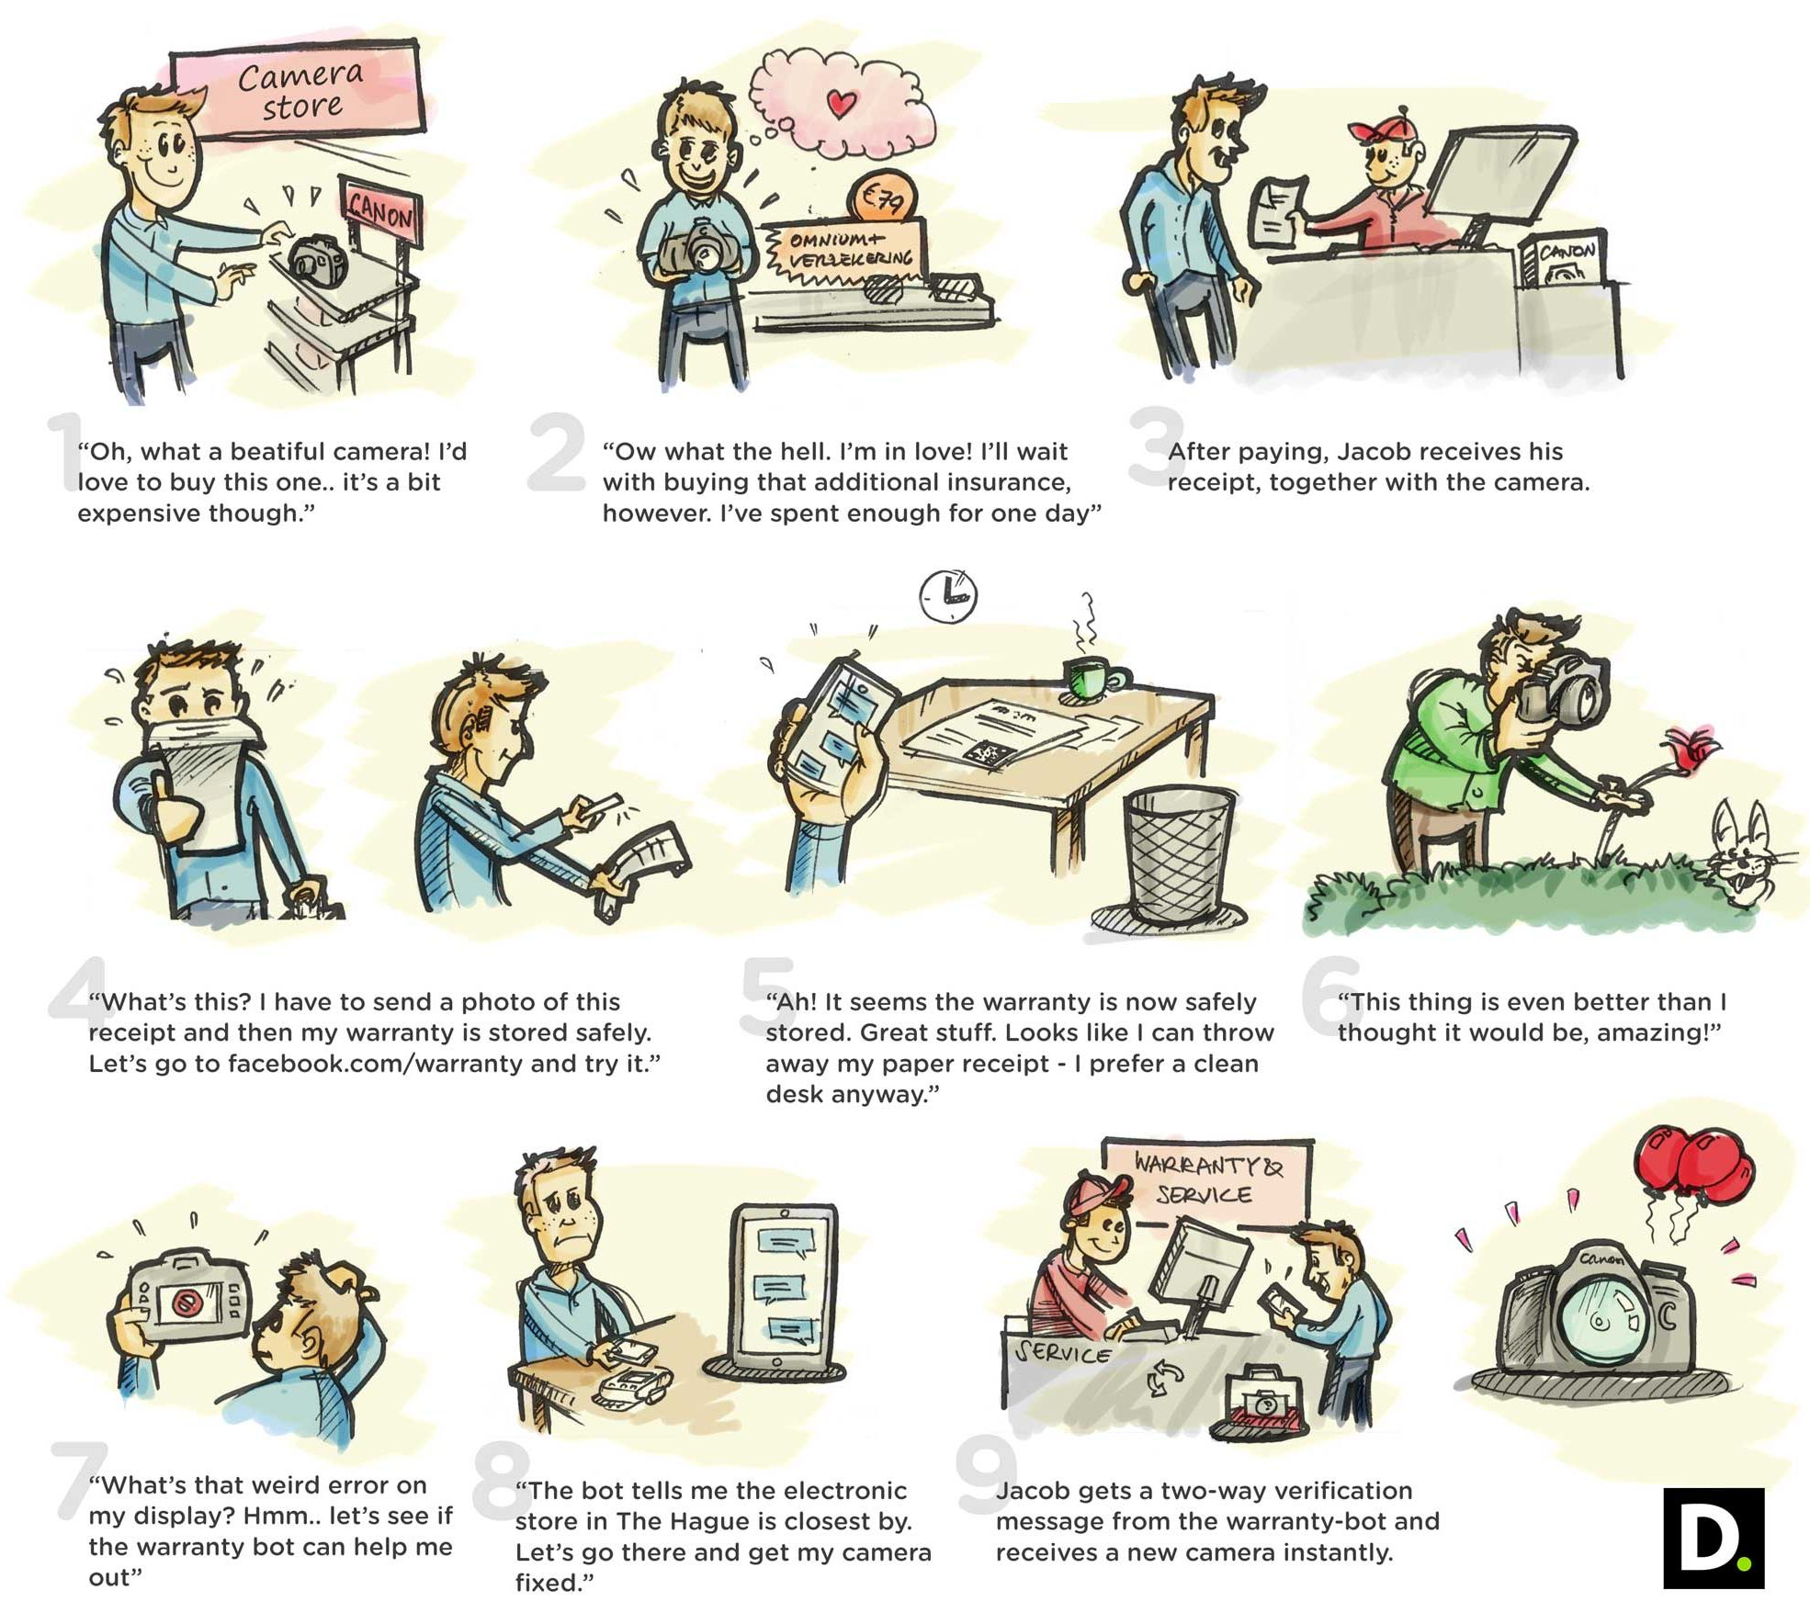

Slide 18
Blockchain technology is being applied to a land registry project in Honduras. Land titles in the Central American country are currently stored on a centralized server, so anyone with admin rights can make changes to the registry without a record of why or how the changes were made and take someone's land away. Blockchain technology offers a way to prevent that kind of criminal activity.

Slide 19
Like most merchants, the world’s largest retailer struggles to identify and remove food that’s been recalled. When a customer becomes ill, it can take days to identify the product, shipment and vendor. With the blockchain, Wal-Mart will be able to obtain crucial data from a single receipt, including suppliers, details on how and where food was grown and who inspected it. The database extends information from the pallet to the individual package.
“It gives them an ability to have an accounting from origin to completion,” said Marshal Cohen, an analyst at researcher NPD Group Inc. “If there’s an issue with an outbreak of E. coli, this gives them an ability to immediately find where it came from. That’s the difference between days and minutes.”
It’s also the difference between pulling a few tainted packages and yanking all the spinach from hundreds of stores, according to Frank Yiannas, vice president of food safety at Bentonville, Arkansas-based Wal-Mart.

Slide 20
A diamond's past is rarely crystal clear. Knowing a stone's origin can stop fencing and insurance frauds and winnow out synthetic diamonds or those sourced in war zones. But forged paper certificates make provenance hard to verify.
Everledger uses more than 40 features, including colour and clarity, to create a diamond's ID. Enshrined in the blockchain, this information becomes a certificate chronicling the jewel's ownership, from mine to ring. Everledger has digitised more than a million diamonds and partnered with firms including Barclays.
The 20-person company has expanded its focus from polished stones to rough ones. This way, Everledger can monitor conflict diamonds, such as those mined in war zones, which frequently sneak into the market in their uncut form.

Slide 21
Overstock.com, though its subsidiary TØ.com, focuses on issuance of private and public securities on a blockchain. In June 2015 it issued its own blockchain-based private bond that was further settled and cleared on the TØ.com blockchain platform. Furthermore, in December 2015 it received SEC approval to issue public securities on a blockchain. Its blockchain-based stock will, once issued, be traded, settled and recorded entirely on a blockchain.

Slide 22
Barclays has been collaborating with Wave, a blockchain start-up that graduated from Barclays‘ accelerator program, that focuses on employing a blockchain with 'dematerialized' trade finance bills of lading documentation(i.e., to set up a completely paperless digital system with no physical records)

Slide 23
Estonia is a great example of a country that is developing blockchain solutions for the official sector. The EstonianeHealth Foundation partnered with blockchain company Guardtime to develop a blockchain-based healthcare record system that provides real-time access to and secures over 1 million patient healthcare records. The country is also developing, in partnership with blockchain start-up Bitnation, a public notary service on a blockchain that would allow Estonian e-residents to notarize records, such as birth and marriage certificates and business contracts, among others

Slide 24
Blockchain start-up Ripple is actively developing enterprise blockchain solutions for international payments. It created a payment protocol and exchange network with a much faster consensus method than the bitcoin blockchain and introduced its own cryptocurrency, the ‘XRP’. In June 2016 Ripple received a virtual currency license in New York
DBS and Standard Chartered PLC partnered up with Ripple in a blockchain-based trade finance trial called 'TradeSafe'. In cooperation with Singapore's IT and telecommunication authority, the 'Infocomm Development Authority', they placed 60 mock trade finance invoices on a blockchain.

Slide 25
Microsoft and IBM have developed open-source platforms that allow developers to create and test their blockchain applications. This unique open-source approach will allow Microsoft and IBM to get many innovations developed on their platforms. Several financial institutions and corporates are leveraging these platforms to build their own blockchain solutions.

Slide 26
Bitcoins & Blockchains
in a minute…

